Slide 1
Rugby Analysis
Greg Westfall – gvw5064@psu.edu
Drew Insley - dki5019@psu.edu
TJ Schaeffer - tjs684@psu.edu
Stephen Polacheck - sjp5665@psu.edu
Isaac Freeman - irf5021@psu.edu

Slide 2
Overview
Examined one possible effect of fatigue: injury
Injury is detrimental to the team, especially in a game of 7’s, so it is imperative to avoid it at all costs
Decided to explore pain, a common precursor to injury
Aimed to find a better way to predict pain other than solely using fatigue
Chose to examine this by using a random forest and regression models

Slide 3

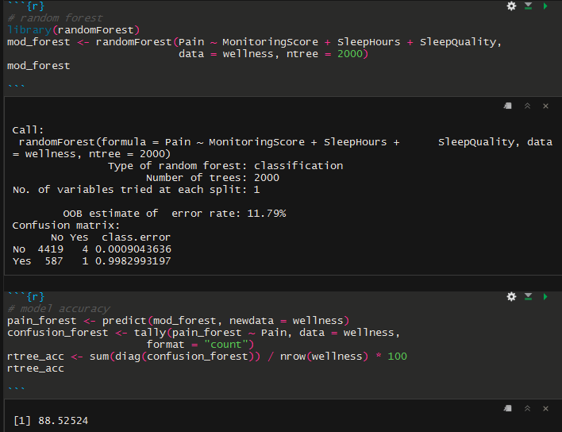
Results
Computed a null model for predicting pain
Made three random forests with the following predictors:
Fatigue
MonitoringScore (Fatigue & other factors)
MonitoringScore, SleepHours, and SleepQuality
Model with most predictors was also most accurate

Slide 4
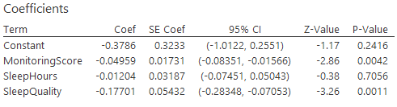
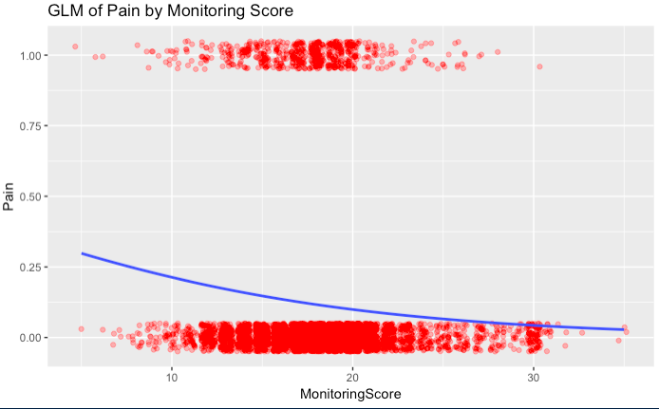
Recommendations
As MonitoringScore and SleepQuality increase, the chance an athlete feels pain goes down
We recommend that coaches:
Emphasize recovery
Find ways to improve athletes’ moods
Ensure athletes are getting good quality sleep

